Slide 1

IEEE 754 Standard Floating-point multiplication using Weighted 2-stage Booth algorithm and Carry Look-ahead Adder
Capstone I
Lê Thanh Hải 1851027
Phạm Tấn Khải 1851081
Instructor: Ph.D. Trần Hoàng Linh

Slide 2
Contents
1
Introduction
2
Theory
3
Design and Implementation
4
Conclusion

Slide 3
Introduction
Reasons and target of this project?
IEEE 754 Standard floating-point is the most common representation today for real numbers on computers.
A multiplier is one of the hardware blocks which generally occupies a significant chip area and is required to be minimized. A lot of applications in which multiplier blocks role an important unit, such as digital signal processing systems or computational techniques.
The main objective is to increase the speed of execution by implementing certain algorithms for multiplying two floating-point numbers.

Slide 4

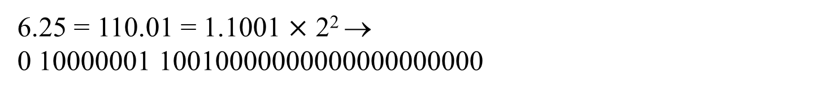
IEEE 754 STANDARD (32 bits)
Sign (a bit) | Exponent (8 bits) | Mantissa (23 bits)
6.25 = 110.01 = 1.1001 $×$ 2² →
0 10000001 10010000000000000000000
Sign: 0 for positive; 1 for negative
Exponent: from 1 to 254
special case: x 000…000 is ruled as ±0 (+ or – depends on x).

Slide 5

Floating-point multiplication
S1 S2 E1 E2 M1 M2
+
Multiplier
-
127
Normalizer
Check overflow/underflow
Final result (32 bits)

Slide 6
Booth algorithm
Booth’s multiplication is an algorithm for multiplying two’s complement representation of signed binary numbers [1]. The algorithm is named to the credit of Andrew Donald Booth, who proposed it in 1950 [2].
In order to multiply two’s complement binary numbers, X*Y, Booth's algorithm implicitly appends a bit y-1 = 0 on the right of Y’s LSB. It examines the pair of bits y_{i} and y_{i-1} by executing the iterations starting from i = 0 to i = N-1. Following execution takes place on comparison:
The product in accumulator P is left unchanged if the compared bits are equal.
The multiplicand times 2^{i} is added to P when y_{i} = 0 and y_{i-1} = 1
The multiplicand times 2^{i} is subtracted from P when y_{i} = 1 and y_{i-1} = 0.
Bit |  | Operation
2⁰ | 2⁻¹
Y_{i} | Y_{i-1}
0 | 0 | 0
0 | 1 | +X
1 | 0 | -X
1 | 1 | 0
Original Booth encoder [3]

Slide 7
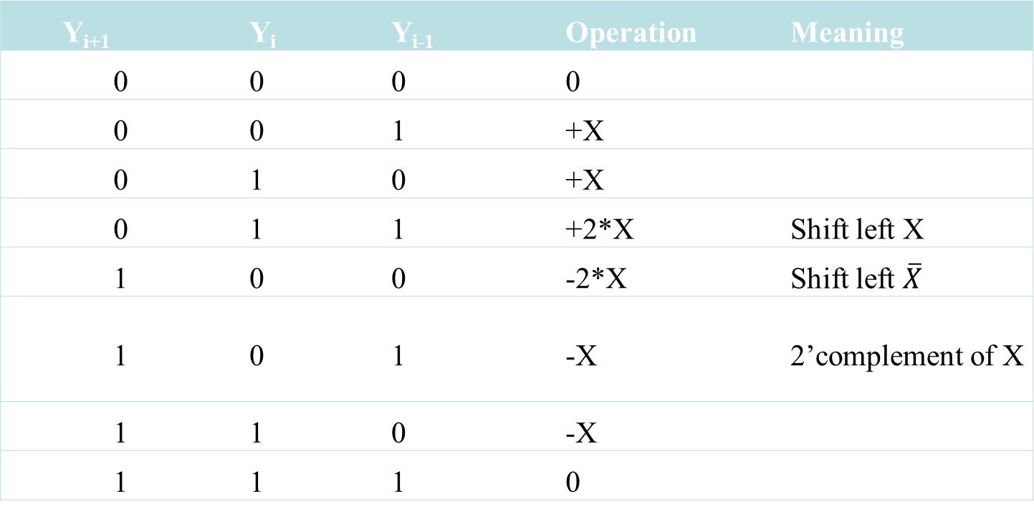
Modified Booth algorithm
Y_{i+1} | Y_{i} | Y_{i-1} | Operation | Meaning
0 | 0 | 0 | 0
0 | 0 | 1 | +X
0 | 1 | 0 | +X
0 | 1 | 1 | +2*X | Shift left X
1 | 0 | 0 | -2*X
1 | 0 | 1 | -X | 2’complement of X
1 | 1 | 0 | -X
1 | 1 | 1 | 0
Improve parallelism due to grouping three bits consecutive concurrently
Reduce the number of PPs up to 2 times in comparison with conventional multiplication.
Y₇ Y₆ Y₅ Y₄ Y₃ Y₂ Y₁ Y₀ Y₋₁

Slide 8
Modified Booth algorithm
The number of PPs can still be reduced using higher radix Booth encoder such as 8-radix, 16-radix or 32-radix encoder.
There are two main problems related to higher radix encoder’s drawbacks. First, extra adder logics are required for higher radix, not just shift bits as in radix-4. Second, larger input MUX are required in the higher radix multiplier.
Number | BOOTH ENCODER | NO. OF CELLS | TOTAL AREA
1 | Radix 2 | 9426 | 27569
2 | Radix 4 | 1690 | 3959
3 | Radix 8 | 2280 | 4359
4 | Radix 16 | 14672 | 32973
5 | Radix 32 | 25703 | 57091
HOWEVER !!!
Number | BOOTH ENCODER | TIME DELAY (ns)
1 | Radix 2 | 23.382
2 | Radix 4 | 13.993
3 | Radix 8 | 14.810
4 | Radix 16 | 26.581
5 | Radix 32 | 27.729
Comparison between different radix Booth algorithm [4]

Slide 9
Radix-16 booth multiplier using weighted 2-stage Booth algorithm
Bit |  | Operation
2⁰ | 2⁻¹
Y_{i} | Y_{i-1}
0 | 0 | 0
0 | 1 | +X
1 | 0 | -X
1 | 1 | 0
PP
PP

Slide 10
Radix-16 booth multiplier using weighted 2-stage Booth algorithm
00000 | 0
00001; 00010 | +1*X
00011; 00100 | +2*X
00101; 00110 | +3*X
00111; 01000 | +4*X
01001; 01010 | +5*X
01011; 01100 | +6*X
01101; 01110 | +7*X
01111 | +8*X
11111 | 0
11110; 11101 | -1*X
11100; 11011 | -2*X
11010; 11001 | -3*X
11000; 10111 | -4*X
10110; 10101 | -5*X
10100; 10011 | -6*X
10010; 10001 | -7*X
10000 | -8*X
0
PP
X
+
2X
4X
+
+
+
PP
8X

Slide 11
Radix-16 booth multiplier using weighted 2-stage Booth algorithm
Y_{g+3} Y_{g+2} Y_{g+1} Y_{g} Y_{g-1} | PP | Y_{g+1} Y_{g} Y_{g-1} | Base PP | Y_{g+3} Y_{g+2} Y_{g+1} | Weighted PP | 2-stage PP (Base PP + Weighted PP)
00000 | 0 | 000 | 0F | 000 | 0F | 0F
00001 | +1 * X | 001 | 1F |  |  | 1F
00010 | +1 * X | 010 | 1F |  |  | 1F
00011 | +2 * X | 011 | 2F |  |  | 2F
00100 | +2 * X | 100 | -2F | 001 | 4F | 2F
00101 | +3 * X | 101 | -1F |  |  | 3F
00110 | +3 * X | 110 | -1F |  |  | 3F
00111 | +4 * X | 111 | 0F |  |  | 4F
01000 | +4 * X | 000 | 0F | 010 | 4F | 4F
01001 | +5 * X | 001 | 1F |  |  | 5F
01010 | +5 * X | 010 | 1F |  |  | 5F
01011 | +6 * X | 011 | 2F |  |  | 6F
01100 | +6 * X | 100 | -2F | 011 | 8F | 6F
01101 | +7 * X | 101 | -1F |  |  | 7F
01110 | +7 * X | 110 | -1F |  |  | 7F
01111 | +8 * X | 111 | 0F |  |  | 8F
10000 | -8 * X | 000 | 0F | 100 | -8F | -8F
10001 | -7 * X | 001 | 1F |  |  | -7F
10010 | -7 * X | 010 | 1F |  |  | -7F
10011 | -6 * X | 011 | 2F |  |  | -6F
10100 | -6 * X | 100 | -2F | 101 | -4F | -6F
10101 | -5 * X | 101 | -1F |  |  | -5F
10110 | -5 * X | 110 | -1F |  |  | -5F
10111 | -4 * X | 111 | 0F |  |  | -4F
11000 | -4 * X | 000 | 0F | 110 | -4F | -4F
11001 | -3 * X | 001 | 1F |  |  | -3F
11010 | -3 * X | 010 | 1F |  |  | -3F
11011 | -2 * X | 011 | 2F |  |  | -2F
11100 | -2 * X | 100 | -2F | 111 | 0F | -2F
11101 | -1 * X | 101 | -1F |  |  | -F
11110 | -1 * X | 110 | -1F |  |  | -F
11111 | 0 | 111 | 0F |  |  | 0F
Y_{i+1} Y_{i} Y_{i-1}
Modified (Radix-4) Booth algorithm
0
X
-X
2X
-2X
5-1 MUX
Base PP
0
4X
-4X
8X
-8X
Weight PP
5-1 MUX
Y_{i+3} Y_{i+2} Y_{i+1}
Schematic of weighted 2-stage Booth encoder for radix 16 [5]

Slide 12
Ripple Carry Adder
A₃ B₃ A₂ B₂ A₁ B₁ A₀ B₀
Full Adder
Full Adder
Full Adder
Full Adder
C₄ C₃ C₂ C₁ C₀
S₃ S₂ S₁ S₀
Ripple Carry Adder (RCA)
Each FA block must wait for the carry to arrive from its previous block. Hence, there will be a considerable time delay (carry propagation delay).
→ Calculating with a number has larger bits, it becomes less efficient regardless its simplicity.

Slide 13
Carry Look-ahead Adder
A | B | Cin | Cout
0 | 0 | 0 | 0
0 | 0 | 1 | 0
0 | 1 | 0 | 0
0 | 1 | 1 | 1
1 | 0 | 0 | 0
1 | 0 | 1 | 1
1 | 1 | 0 | 1
1 | 1 | 1 | 1
(A xor B) and Cin
A and B
Full Adder truth table

Slide 14
Carry Look-ahead Adder
A xor B  called “carry generate” or G
Cout = G + P . Cin
A and B  called “carry propagate” or P
➢ Expanding with any FA blocks, the general equation becomes C_{n} = G_{n} + P_{n} . C_{n-1}
C₁ = G₁ + P₁ . C₀
C₂ = G₂ + P₂ . (G₁ + P₁ . C₀) = G₂ + P₂ . G₁ + P₂ . P₁ . C₀
C₃ = G₃ + P₃ . (G₂ + P₂ . G₁ + P₂ . P₁ . C₀) = G₃ + P₃ . G₂ + P₃ . P₂ . G₁ + P₃ . P₂ . P₁ . C₀
etc.
Any element is available (as they depend only on inputs, that are A, B, C₀)
The delay time now is the same for any carry bit→faster add operations are provided. However, CLA is complicated as the number of variables increase.

Slide 15
DESIGN AND IMPLEMENTATION
Overflow (1 bit)
First FP number (X)
Underflow (1 bit)
Floating Point Multiplier
Sign (1 bit)
Second FP number (Y)
Exponent (8 bits)
Mantissa (23 bits)

Slide 16
DESIGN AND IMPLEMENTATION
M1
M2
E1
E2
S1
S2
Mantissa Multiplier
NORMALIZATION-UNIT
Overflow/underflow?
Exponent calculator
XOR

Slide 17
DESIGN AND IMPLEMENTATION
Pre-process of exponent calculator
Special cases
F
E:11111111
overflow
T
E:00000000
F
T
exponent calculator
underflow

Slide 18
DESIGN AND IMPLEMENTATION
Exponent calculator
This sub-block adds the exponents of two FP numbers and then minus the bias (127₁₀) to get the exponent before normalizing. Before calculating, they are extended to 9 bits by adding bit 0 to the left of MSB.
The bit just added plays a role as an announcement of overflow/underflow.
E1
E2
9-bit RCA
9-bit RCA
127

Slide 19
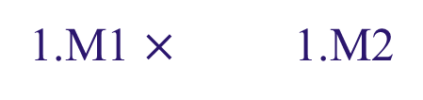
DESIGN AND IMPLEMENTATION
Mantissa multiplier
Pre-process
Bit 0 must be added to the right of LSB of the multiplier Y before calculating.
Booth algorithm is used for signed multiplication, and in this situation, the “hidden bit” 1 accidentally indicates the negative number. This is wrong because mantissa multiplication is an unsigned one. Extending multiplier and multiplicand by adding “virtual” bit 0, which informs that they are an unsigned number.
00001• • • ♦ • • • ♦ • • • ♦ • • • ♦ • • • ♦ • • • 0
0000
0000
0
Multiplicand: 28 bits
Multiplier: 29 bits

Slide 20
DESIGN AND IMPLEMENTATION
Mantissa multiplier
Multiplicand (28 bits)
0
X
2*X
-X
-2*X
Base PP encoder
♦ • • • ♦
31 bits
0
4*X
8*X
-4*X
-8*X
Weighted PP encoder

Slide 21
DESIGN AND IMPLEMENTATION
X
Mantissa multiplier
LSB • • • Multiplier (29 bits) • • • MSB
Weighted 2-stage Booth algorithm block
CLAs
<< 4 bits
<< 8 bits
<< 12 bits
<< 16 bits
<< 20 bits
<< 24 bits
5 bits

Slide 22
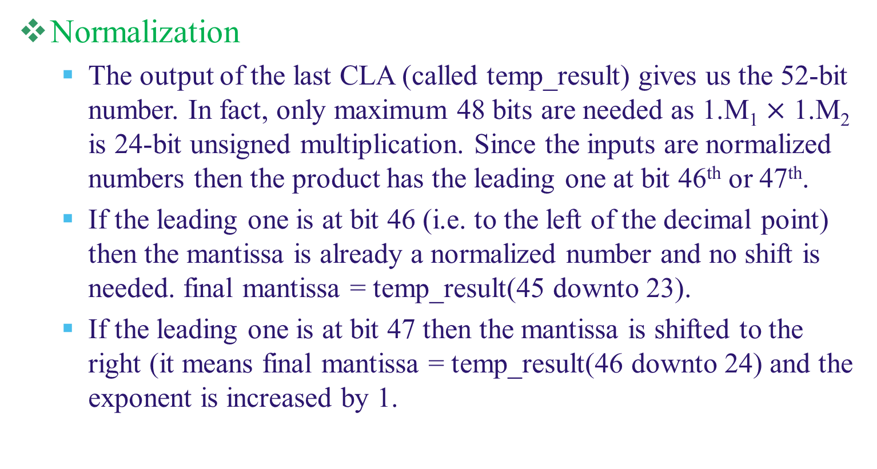
DESIGN AND IMPLEMENTATION

Slide 23
DESIGN AND IMPLEMENTATION
Ex Ey
1 xxxx xxxx ?
F: after normalization
T
0 0xxx xxxx ?
F
9-bit RCA
9-bit RCA
T
Underflow
Overflow
127
T: all 1s
T: all 0s
1111 1111 or 0000 0000 ?
F
No overflow/underflow

Slide 24
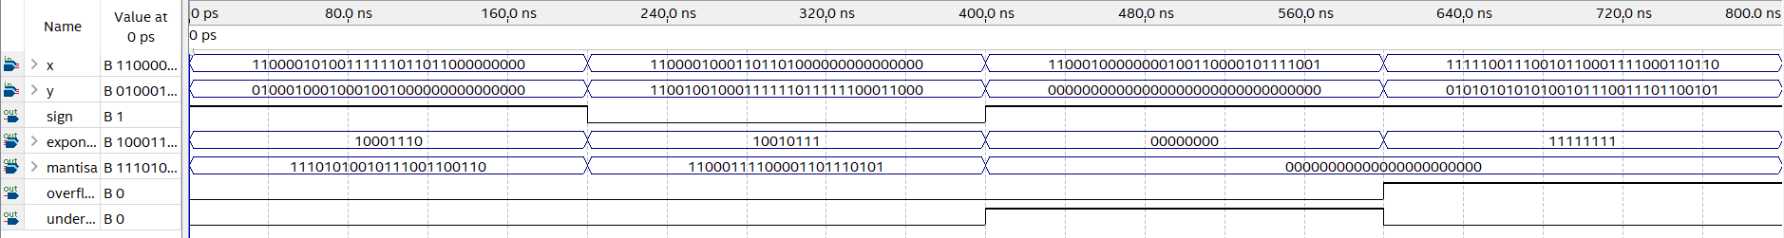
RESULT
x | -79.85546875 | -45,625 | -521.52301025390625 | -1.31831126611e+35
y | 786 | -654321.5 | 0 | 1.44932046111e+13
Calculated result | -62766.3984375 | 29853418 | -0 | NA
Exact result | -62766.3984375 | 29853418.4375 | 0 | NA
Overflow | 0 | 0 | 0 | 1
Underflow | 0 | 0 | 1 | 0

Slide 25
CONCLUSIONS
Another method to multiply 2 numbers represented in IEEE-754, which also improves the speed,
Inform the overflow/underflow of the calculation.
Applying successfully some algorithms of signed multiplication into our FP multiplication design.
Cannot multiply all real numbers in decimal as they cannot represent in IEEE-754 exactly.
The input and output are represented in binary, which is not as friendly as decimal representation.
Single FP (32 bits), in some cases, do not have enough bits to ensure the accuracy.

Slide 26
DEVELOPMENTS
The design can be upgraded to double FP IEEE-754 (64 bits), which gives us a more exact representation of the FP number.
Build a converter from decimal to IEEE 754 standard representation and vice versa. This converter allows users to input decimal numbers, which are familiar to us.

Slide 27
REFERENCES
[1] Ila Chaudhary, Romika Choudhary, Gagandeep Kaur, Ashish Vats and Deepika Kularia, “Design and Comparison of High-speed Radix-8 and Radix-16 Booth’s Multipliers”, International Journal of Computer Applications (0975 – 8887), Volume 181 – No.2, July 2018.
[2] Andrew D. Booth, “A signed binary multiplication technique”,1950.
[3] Mervat Mohammed Adel Mahmoud, “A parallel binary/decimal fixed-point multiplier with binary partial products accumulation”, faculty of Engineering, Cairo university, 2011.
[4] JasbirKaur, Sumit Kumar, “PERFORMANCE COMPARISON OF HIGHER RADIX BOOTH MULTIPLIER USING 45nm TECHNOLOGY,” IJIRSET (An ISO 3297: 2007 Certified Organization), Vol. 5, Issue 1, January 2016, ISSN(Online): 2319-8753, ISSN (Print): 2347-6710.
[5] Hyunpil Kim, Sangook, “Radix 16 booth multiplier using novel weighted 2-stage booth algorithm” IEICE Electronics express, vol. 11, no. 13, June 2014.
[6] V Rajaraman, “IEEE Standard for Floating Point Numbers”, January 2016.
[7] Naresh Grover, M.K.Soni, “Design of FPGA based 32-bit Floating Point Arithmetic Unit and verification of its VHDL code using MATLAB”, Published Online February 2014 in MECS (available at http://www.mecs-press.org/) DOI: 10.5815/ijieeb.2014.01.01.
[8] O. L. MacSorley, “High-speed arithmetic in binary computers”, Proc. IRE, Jan. 1961, vol. 49, pp. 67-91.

Slide 28
THANK YOU !!!

